Slide 1
Cloud agnostic deployment and Canary Release
siemens.com/mindsphere
Restricted © Siemens AG 2017
Notes:
“Cloud Agnostic Deployment and Canary Release”. Here we are talking about 2 things, first, ‘Cloud Agnostic Deployment’ and second, ‘Canary Release’. Does anyone know what these terms mean? <Let audience say yes or no, in any case we would need to explain what these terms are>
Fair enough, so if I have to tell you in short, ‘Cloud Agnostic Deployment’ is deploying your application to multiple clouds (AWS, Azure etc.) using same technique/pipeline, while Canary Release is incrementally deploying your application. So that it can be tested to a sub-set of users and if required can be rolled back or continue to deploy for all users.
Yes, I owe you more details ☺. So let’s try to understand the concept with a Business Case.

Slide 2

Emergency Board meeting to discuss poor results and way forward
ABC
MOM
Form a Task Force including IT and Business Owners to Brainstorm
ABC
Propose strategy and report back in 2 weeks
Discussion Points
ABC
Minute of Meetings
Key Directives to focus on:
Agility
Cost
Vulnerability
CEO leading Board Meeting of BestPLM.INC
ABC
ABC

Slide 3
Emergency Board meeting of BestPLM.INC to discuss poor results and way forward:
Minutes of meeting:
Form a Task Force including IT and Business Owners to Brainstorm
Propose strategy and report back in 2 weeks
Key Directives to focus on:
Agility
Cost
Vulnerability
Fast Competitor Launches
Agility
Slow Time to Market
Security and Reduce Vulnerability
High CAPex/ OPex/TCO
Up/Downscale/ Move of Apps and Workload
Multi Geo-Compliance
CEO leading Board Meeting of BestPLM.INC
Data Sovereignty

Slide 4
XYZTech - Case Study
Company XYZTech is a leading product based company in PLM domain.
Recently their stakeholders realized some threat from competitors, also they are not happy with the financial report of 2017. It was noticed that the company’s products need to be more agile with respect to releasing new services, features and fixing bugs. This is the only way they can continue to dominate the market and keep their customers happy.
This problem is now handed over to technical team for internal brainstorming and suggestions…
Notes:
Company XYZTech is a leading product based company in PLM domain.
Recently their stakeholders realized some threat from competitors, also they are not happy with the financial report of 2017. It was noticed that the company’s products need to be more agile with respect to releasing new services, features and fixing bugs. This is the only way they can continue to dominate the market and keep their customers happy.
After internal brainstorming and multiple discussions XYZTech stakeholders setup some directions for it's software development team::
1) Support for frequent releases, instead of having standard periodic release cycle. They cited examples of Amazon and Microsoft who are releasing new features in seconds and minutes.
2) Cost effective and avoid vendor lock-in.
3) System should to handle spikes gracefully within defined SLAs during peak hours.
4) System should scale up or down on demand.
5) Release new features/services to target region (ex: North America) or set of users (ex: users under age 25 years).

Slide 5

Business Requirement
Brainstorming
Key Focus Areas
Solution
No Downtime
Time to market
Automatic & Quick Rollback
Target release
Frequent Releases
Region
Scope
Deployment Techniques
Minimize operational cost
Pay as you go
On demand scaling
Monitoring and auto-healing
Cloud
Avoid vendor lock-in
AzureCloud
AWS Cloud
3rd Party Cloud
Multi-cloud
Notes:
If we closely follow the directions set by stakeholders, we can divide requirements in 3 broad categories –
Time to market – Yes, in today’s competitive world it’s very important to release features/services in frequent intervals. But with this requirement there are some hidden challenges –
No Downtime - With releases in seconds and minutes, we cannot afford downtime
Rollback – If something goes wrong we need quick and automatic rollback
Target release – We should be able to rollout new feature/service for particular geography or age group etc.
Minimize operation cost –
Pay as you go – Instead of investing huge money in buying hardware and software licenses, our expenses should be based on the usage.
On demand scaling – Our product should be able to perform within defined SLAs even if the load increases excessively. For this, hardware should be provisioned as an when required.
Monitoring and auto-healing -
Avoid vendor lock-in
Moving to the cloud is not easy task--nor is moving out of it. If you house all of your workloads in a single cloud but then that cloud service provider starts raising prices or making other changes that negatively affect your performance, business needs, or costs, you might be faced with the tough choice of staying put and accepting the changes or going through a second migration.
From 3 broad categories, Software team has reached to below conclusion –

Slide 6
Brainstorming
MultiCloud

Slide 7
Challenges in Applications: AS-IS
Public
Dedicated
On-premise
Hybrid
Multi-cloud
Monolith
Deployment Challenge(s)
Avoid Downtime
Feature release
Automatic Rollback
Controlled Environment

Slide 8
Why Multi-Cloud?
Optimized ROI
Superior Security
Low Latency
Autonomy
Less Disaster Prone
Multi Cloud
Notes:
Optimized ROI : With the multi-cloud environment, you can spin up whatever cloud resources are on offer without having to compromise your choices. Multi-cloud infrastructure offers a rich set of cloud options to solve rigorous needs across a diverse range of computing and business functions, thereby optimizing returns on cloud investments.
Superior Security : Multi-cloud infrastructure allows organizations to maintain a hybrid cloud environment that enables a combination of security and cost savings at the same time. The most security-focused workloads are kept in the private cloud while running regular business data and apps in cost-effective public cloud networks.
Low Latency : With the multi-cloud infrastructure, the datacenter closest to end-users can serve the requested data with minimum server hops. This capability is especially useful for global organizations that needs to serve corporate data across geographically disparate locations while maintaining a unified end-user experience.
Autonomy : Multi-cloud infrastructure empowers organizations to mix and match platforms and vendors such that their workloads are not locked-in to individual cloud providers. Switching vendors gets easier, simplified and fairly automated at times since workload performance is never tied to individual vendors. With the lower vendor lock-in, customers get the autonomy to address changing business needs for performance, security and returns on investments.
Less Disaster Prone : Distribute your workload across multiple cloud networks with each offering the same low SLA guarantee and the possibility of concurrent and simultaneous downtime across all clouds still goes down exponentially. Even if this possibility is not negligible, organizations can enjoy greater options in reacting proactively to mitigate risks when needed.

Slide 9
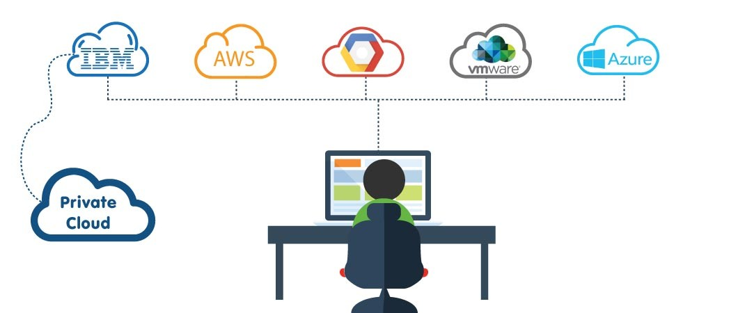
Why Multi-Cloud?
Customization with Cloud-specific Powers
Reduction in Expenditure
Enhanced Autonomy
Risk Management
Focusing on Business Goals

Slide 10
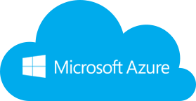
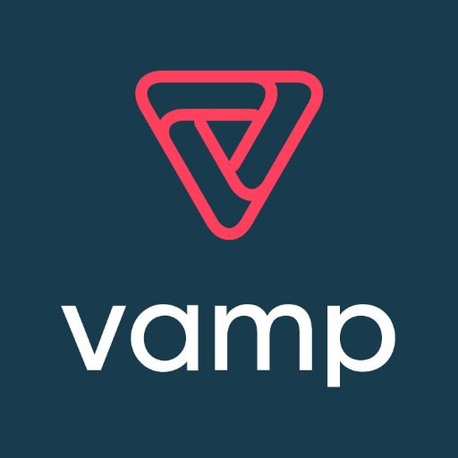
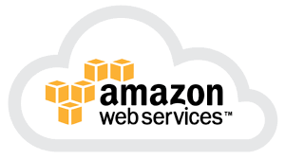

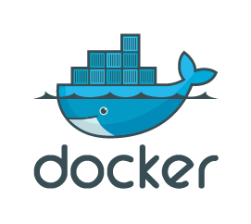
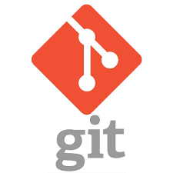
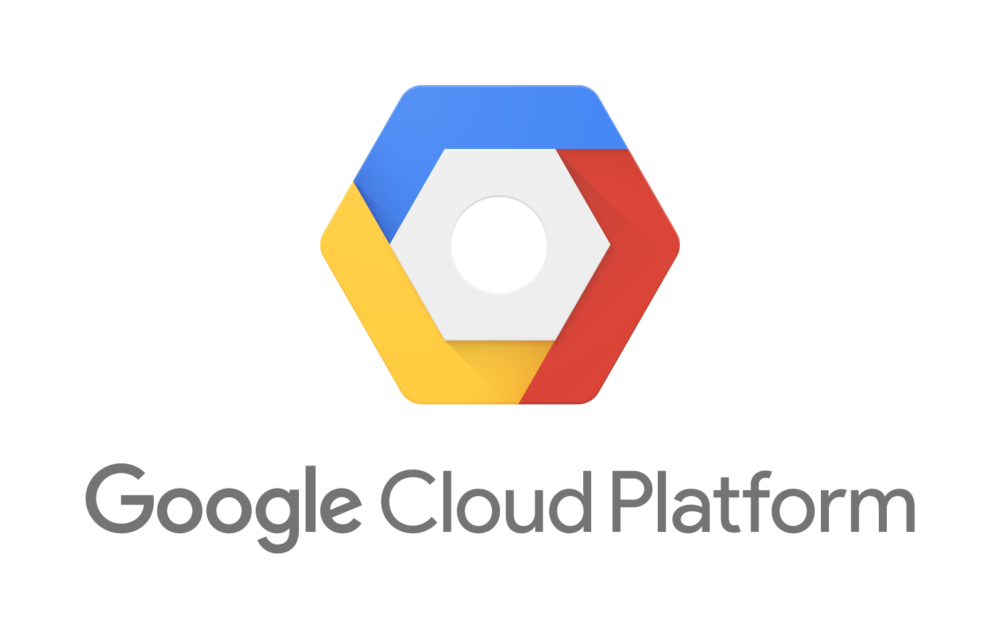
Cloud agnostic pipeline
2
3
4
1
Build Application
For AWS Platform
Build Application
For Azure Platform
5
1
2
3
4
5
Cloud agnostic spring application
Build Application code for specific platform
Store Application in docker hub
Access Application on different cloud
Deployment techniques

Slide 11
Cloud agnostic pipeline
2
3
1
Build Application
For AWS Platform
Build Application
For Azure Platform
Cloud agnostic spring application
Build Application code for specific platform
Deployment techniques

Slide 12
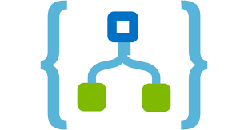
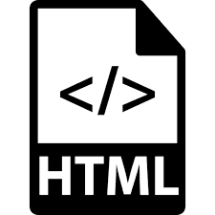
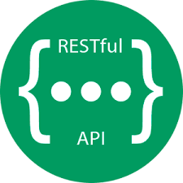

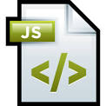
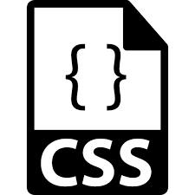


Multi-cloud coding
Business layer
Presentation layer
Cloud Specific implementation
DynamoDB
RDS
SQS
Rest API layer
DocumentDB
SQL DB
Service Bus
Infrastructure layer
Cloud Datastore
CloudSQL
Cloud Pub/Sub

Slide 13
Multi-cloud coding
Presentation layer
Rest API layer
Business layer
Infrastructure layer
AWS (SQS, DynamoDB, RDS)
Azure (Service Bus, DocumentDB, SQL DB)
GCP (Cloud Pub/Sub, Cloud Datastore, Cloud SQL)
Same across cloud providers
Same across cloud providers
Same across cloud providers

Slide 14
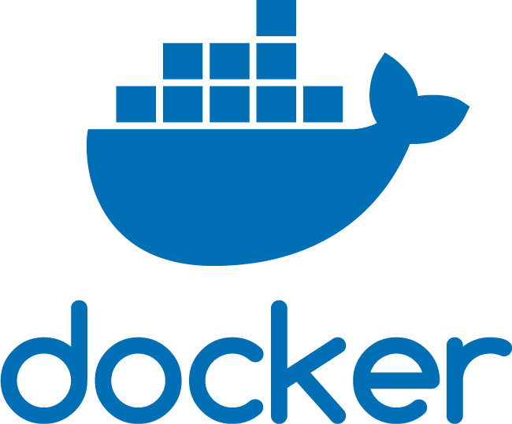

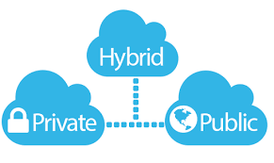


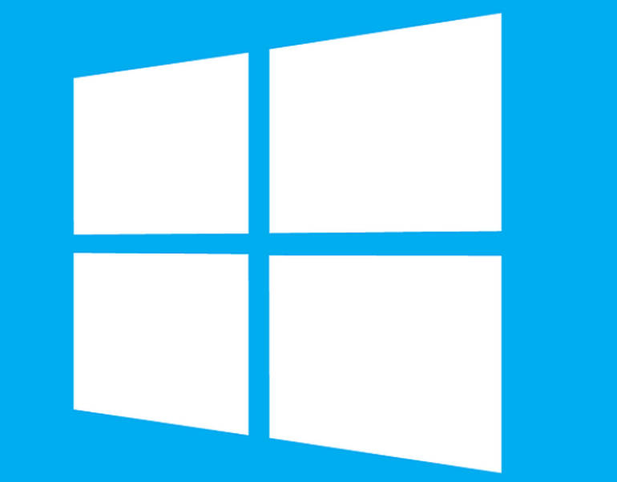
Technology Stack
Workflow / Application Management
Scheduling and Operations
Container Engine
Operating System
Cloud Provider

Slide 15

Deployment techniques
Rolling deployment
Canary deployment
Vamp
Spinnaker
Istio
Blue/Green deployment
Rolling deployment
Canary
deployment
Blue/Green
deployment

Slide 16
Deployment techniques
Rolling deployment
Canary deployment
Blue/Green deployment
Rolling deployment
Canary deployment
Vamp
Spinnaker
Istio
Blue/Green deployment

Slide 17

Rolling updates
Notes:
Rolling Strategy : A rolling deployment slowly replaces instances of the previous version of an application with instances of the new version of the application. A rolling deployment typically waits for new pods to become ready via a readiness check before scaling down the old components. If a significant issue occurs, the rolling deployment can be aborted.

Slide 18
How Canary works?
Flight booking application with 3 micro-services
Current release
Gateway
User Management 1.0
Flight Search 1.0
Customers
90%
Flight Booking 1.0
Customers
10%
If everything is working fine, deploy API on rest of the instances
Deploy new API version on these VMs/Containers
Canary Customers
Flight Booking 1.1
VMs / Containers

Slide 19
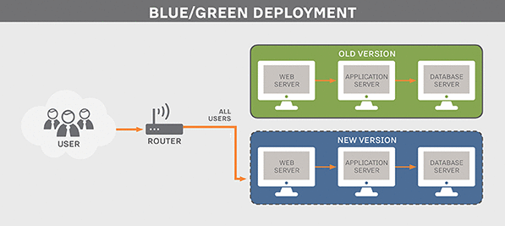
Blue/Green
Notes:
Blue/Green Deployment : The blue-green deployment approach does this by ensuring you have two production environments, as identical as possible. At any time one of them, let's say blue for the example, is live. As you prepare a new release of your software you do your final stage of testing in the green environment. Once the software is working in the green environment, you switch the router so that all incoming requests go to the green environment - the blue one is now idle.
Blue-green deployment also gives you a rapid way to rollback - if anything goes wrong you switch the router back to your blue environment.
Issues : There's still the issue of dealing with missed transactions while the green environment was live, but depending on your design you may be able to feed transactions to both environments in such a way as to keep the blue environment as a backup when the green is live. Or you may be able to put the application in read-only mode before cut-over, run it for a while in read-only mode, and then switch it to read-write mode. That may be enough to flush out many outstanding issues.

Slide 20
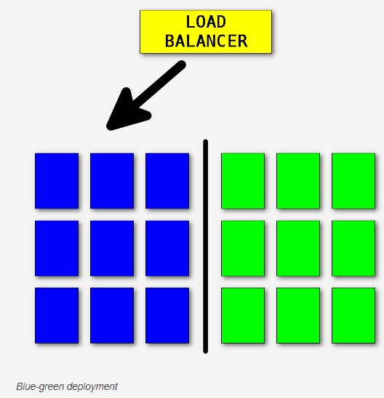
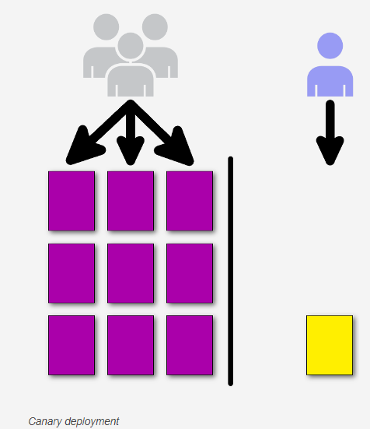
Why Canary?
The essence of blue-green is deploying all at once
The essence of canary deployment is deploying incrementally to a small subset of users.
You need to do a canary release
If you're not completely certain that the new version will function correctly in production.
Rollout the new version to a region or a specific location first;
If you have multiple brands you can rollout to a single brand first
Multiple strategies can be used such as the first one being visible only to their internal employees and having all the Feature Toggles turned on so they can detect problems with new features early.
Ability to do capacity testing of the new version in a production environment by slowly ramping up the load and monitoring the metrics with a safe rollback strategy if issues are found.
Canary releases can be used as a way to implement A/B testing.

Slide 21
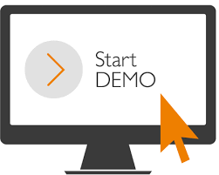
Demo

Slide 22

Demo

Slide 23

Thank You!

